Slide 1







Docker-compose, vagga і інші «страшні» слова
bit.ly/msp-docker

Slide 2

About me
Work as DevOps Engineer at PDFfiller
IT KPI (co-founder)
Linux & Open Source enthusiast
In love with JavaScript & Python
Write on Bash and PHP

Slide 3
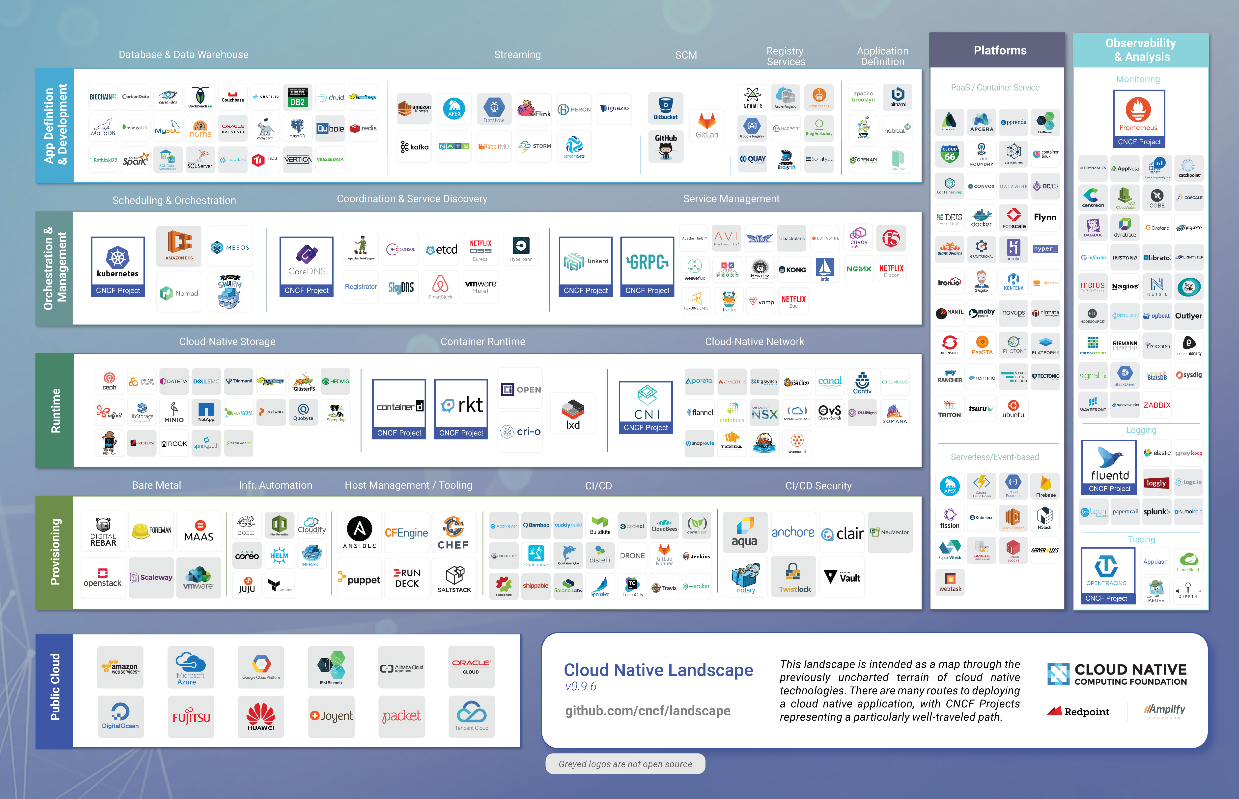
So many…

Slide 4
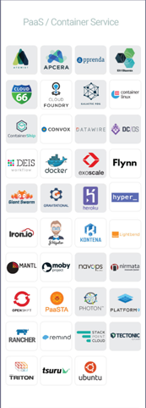
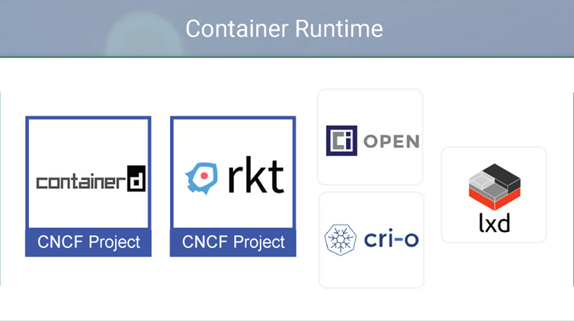
So many…

Slide 5
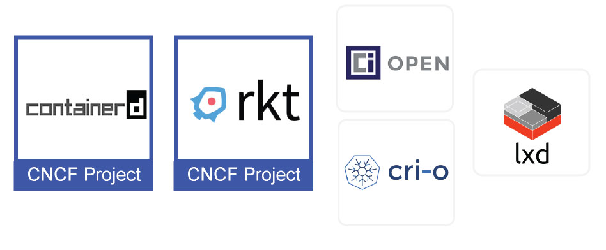
Container runtime

Slide 6
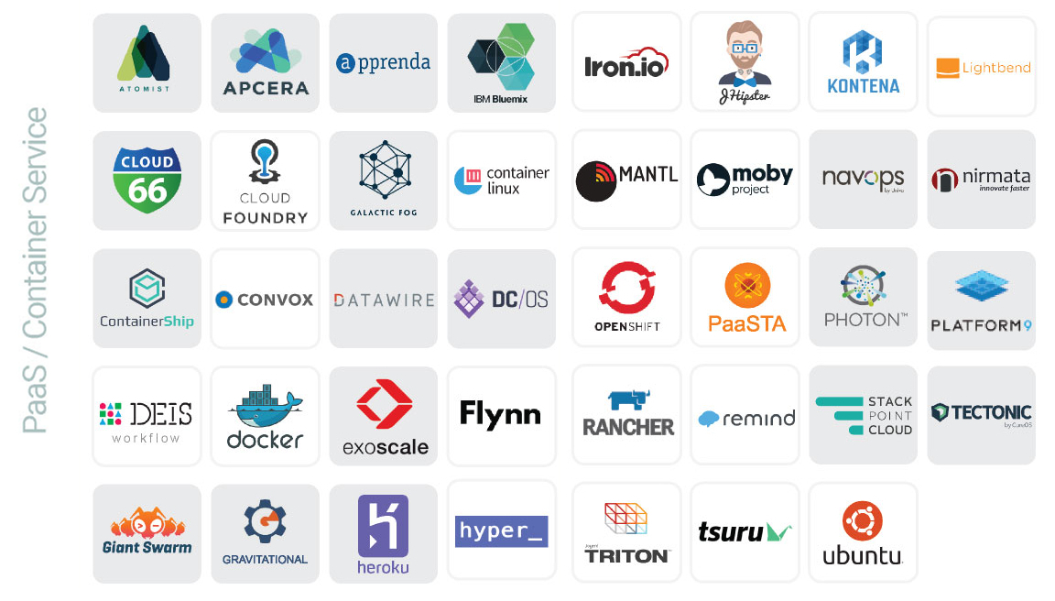
Container services & PaaS

Slide 7
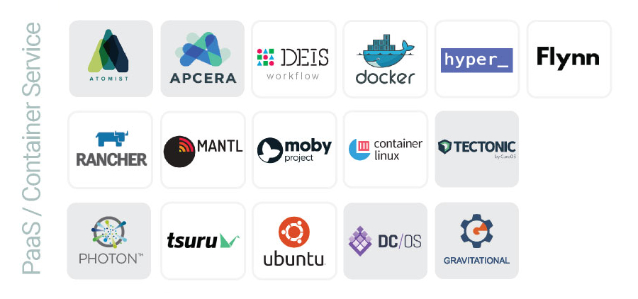
Services, which can run local

Slide 8
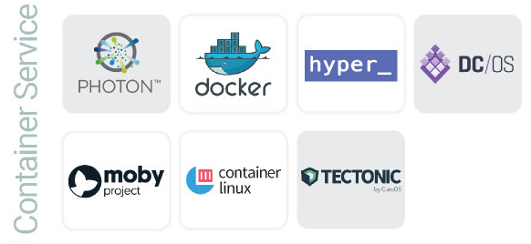
Just container services, which can run local

Slide 9
Docker

Slide 10
Dockerfile

Slide 11
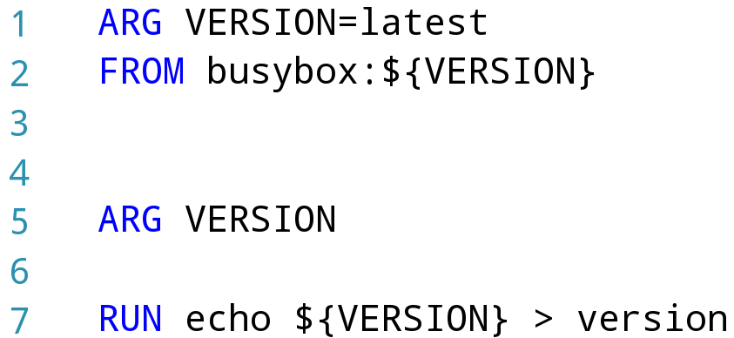
Dockerfile

Slide 12
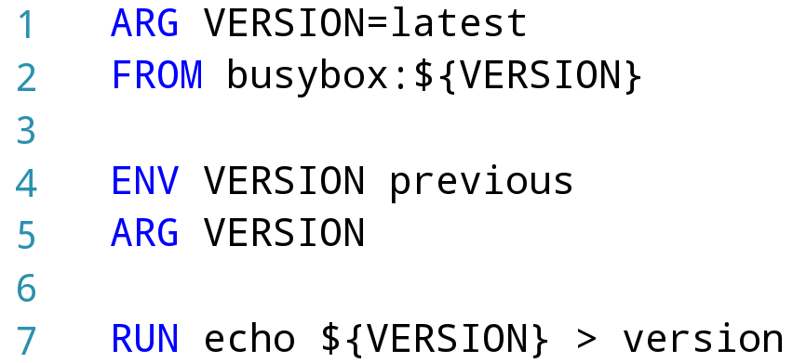
Dockerfile

Slide 13
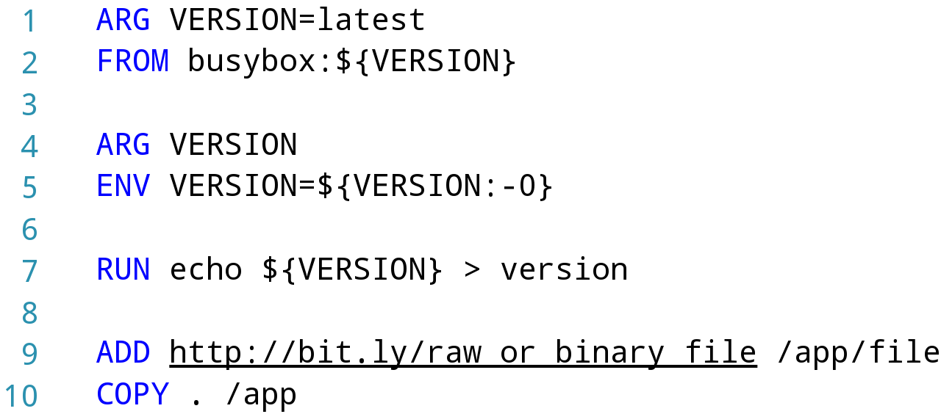
Dockerfile

Slide 14
Dockerfile

Slide 15
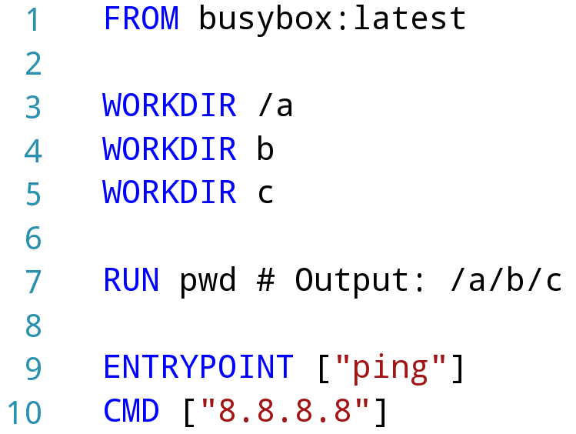
Dockerfile

Slide 16
Dockerfile

Slide 17
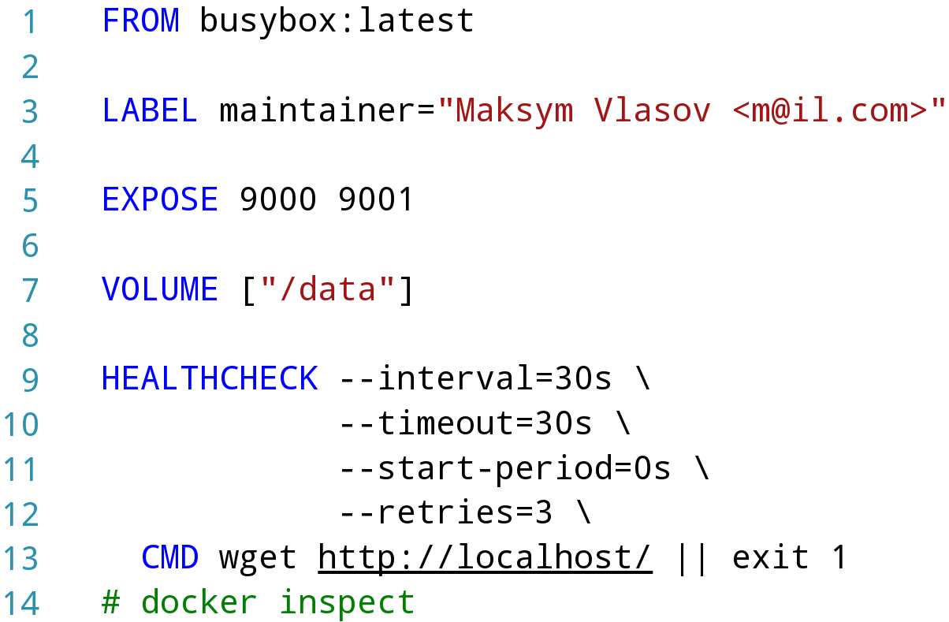
Dockerfile

Slide 18
Dockerfile

Slide 19
Dockerfile

Slide 20
Dockerfile

Slide 21
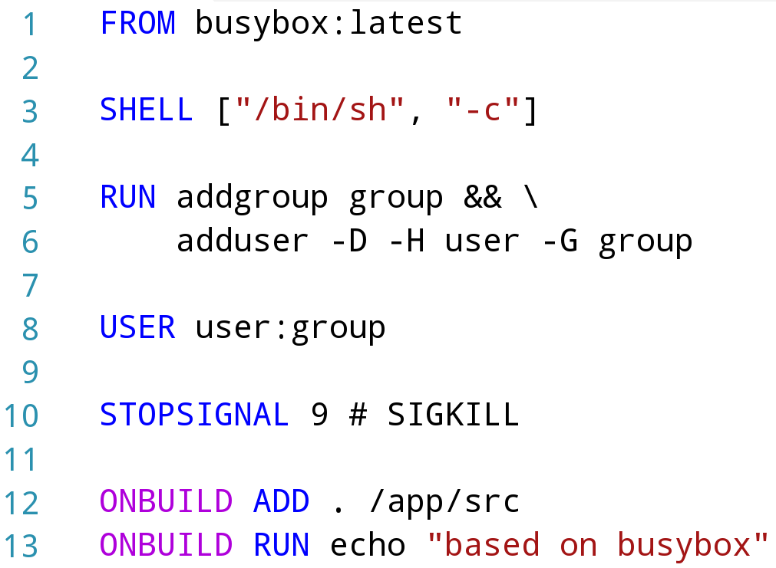
Dockerfile

Slide 22
Dockerfile

Slide 23
Dockerfile

Slide 24
Dockerfile

Slide 25
Docker CLI

Slide 26
Docker CLI
docker login

Slide 27
Docker CLI
docker login
docker run -ti --name name busybox
docker exec -ti name sh

Slide 28
Docker CLI
docker login
docker run -ti --name name busybox
docker exec -ti name sh
docker attach name
docker rename name container

Slide 29
Docker CLI
docker pause container
docker unpause container

Slide 30
Docker CLI
docker pause container
docker unpause container
docker inspect container
docker top container
docker stats container

Slide 31
Docker CLI
docker pause container
docker unpause container
docker inspect container
docker top container
docker stats container
docker system prune --volumes

Slide 32
Docker-compose

Slide 33
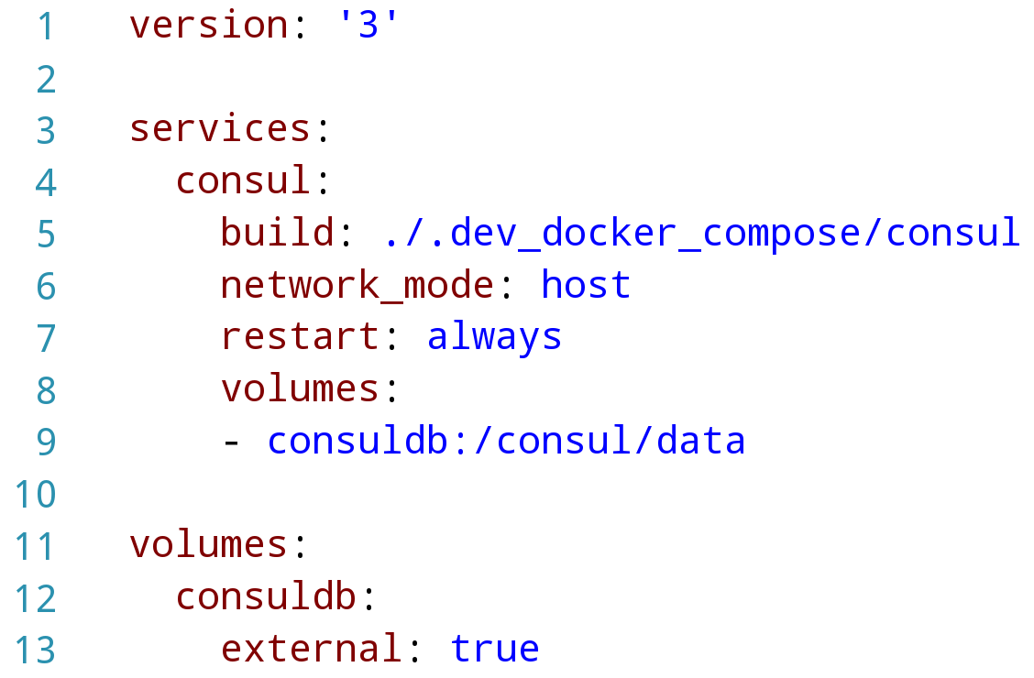
Docker-compose.yaml

Slide 34
Docker-compose.yaml

Slide 35
Docker-compose.yaml

Slide 36
Docker-compose.yaml

Slide 37
Docker-compose.yaml

Slide 38
Docker-compose.yaml

Slide 39
Docker-compose.yaml

Slide 40
Docker-compose CLI

Slide 41
Docker-compose CLI
docker-compose ps

Slide 42
Docker-compose CLI
docker-compose ps
docker-compose config # validation & view

Slide 43
Docker-compose CLI
docker-compose ps
docker-compose config # validation & view
docker-compose pause
docker-compose unpause

Slide 44
Docker-compose CLI
docker-compose run service ls
docker-compose exec consul ls

Slide 45
Docker-compose CLI
docker-compose run service ls
docker-compose exec consul ls
docker-compose top

Slide 46
Docker-compose CLI
docker-compose run service ls
docker-compose exec consul ls
docker-compose top
docker-compose images

Slide 47
Docker-compose CLI
docker-compose run service ls
docker-compose exec consul ls
docker-compose top
docker-compose images
docker-compose down # prune

Slide 48
Vagga

Slide 49
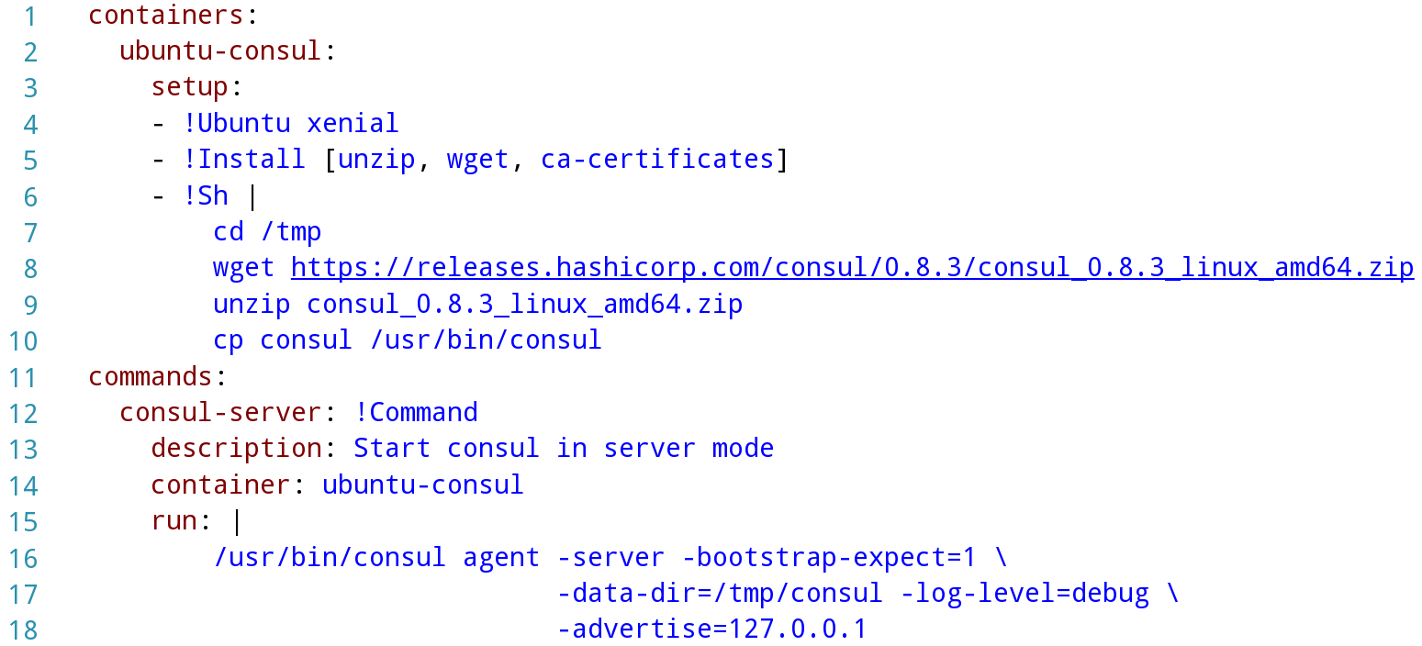
vagga.yaml

Slide 50
vagga.yaml

Slide 51
vagga.yaml

Slide 52
vagga.yaml

Slide 53
vagga.yaml

Slide 54
vagga.yaml

Slide 55
vagga.yaml

Slide 56
Dev-docker-compose

Slide 57
.generate.yaml

Slide 58
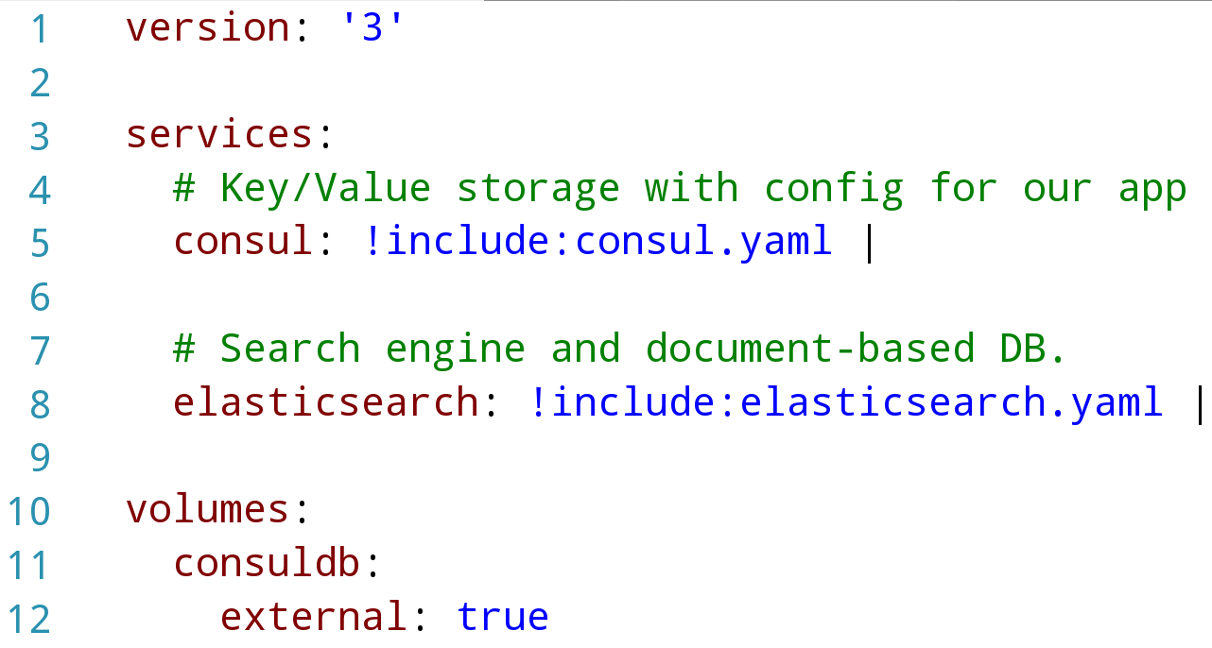
.generate.yaml

Slide 59
.generate.yaml

Slide 60
.generate.yaml

Slide 61
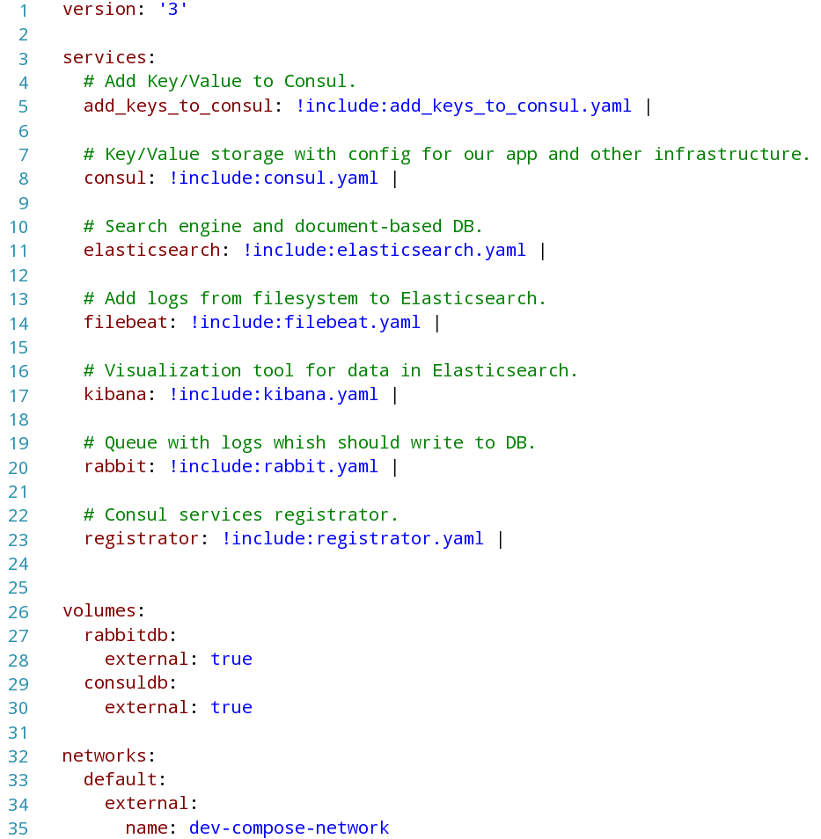
Dev-… vs docker-compose

Slide 62
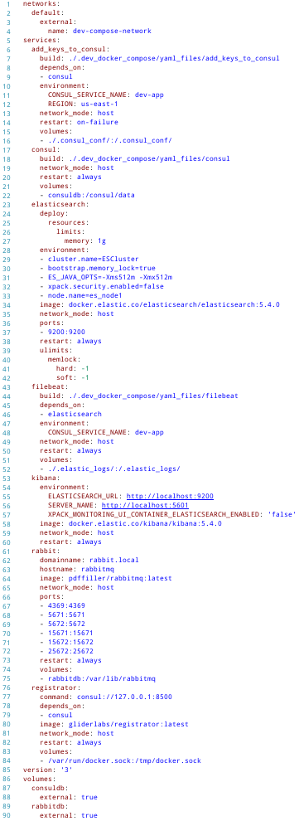
Dev-… vs docker-compose

Slide 63
Dev-… vs docker-compose

Slide 64
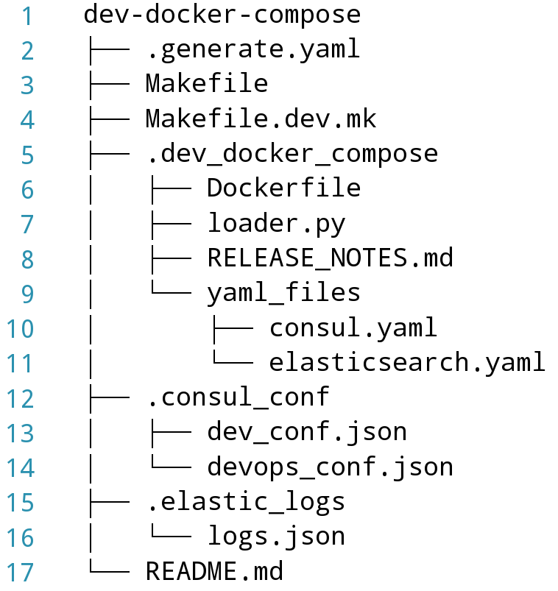
Structure

Slide 65
Structure

Slide 66
Structure

Slide 67
Structure

Slide 68
Structure

Slide 69
Structure

Slide 70
Structure

Slide 71
Questions?
fb.com/maxymvlasov
@maxymvlasov
bit.ly/msp-docker

